Slide 1

First-cry E-commerce website.
Gurijala Lakshmi venkata Sai chandu(2586991)
Kokkanti lokesh(2587024)
Anupam mishra(2587363)
Nandeesh N (2586652)
Kaliga vinay kumar(2587014)
Rapaka Hiranmai(2587325)
Thamatam Guru Chandana(2586685)
Meegada Sunitha(2587017)
Real Life Lab(RLL)
Group-1

Slide 2

CONTENTS:
Introduction
Selenium
Cucumber
TestNG
POM Framework
Listeners
IRetryAnalyser
Extent Reports
Data Driven Testing
Screenshots&Logs
JIRA
Outputs

Slide 3
INTRODUCTION:
In this project we are testing the functionalities of the website:firstcry.com
First we have started testing with writing the manual test cases.
The tools and Framework which we have worked with are: Selenium, TestNG, Cucumber.
We have created the extent reports and generated logs.
For the failed test cases we have used IRetry Analyser and screenshots for capturing the failed test cases.
We have Excel to read data.
In this project , we have used Jira for the test management lifecycle.

Slide 4
SELENIUM:
Open Source Tool:
Selenium is an open source tool that enables testers to automate web application across different browser.
Automated Testing
With Selenium, testers can perform automated testing of web applications, reducing manual effort and ensuring consistent test result.
ADVANTAGES:
Automation Efficiency
Cross Browser Testing
Parallel Execution

Slide 5
Implementing Selenium for testing on the Firstcry ecommerce website
Setup Selenium
Identifying test scenarios
Writing test scripts
Running tests
Analyzing results
Maintenance
Integration with CI/CD

Slide 6

CUCUMBER
Cucumber is a powerful open-source testing tool that facilitates Behavior-Driven Development (BDD) by allowing collaboration between developers, testers, and non-technical stakeholders.
Key features of Cucumber:
Feature files
Step Definitions
Tags
Rich Reporting

Slide 7
ADVANTAGES OF USING CUCUMBER:
Collaboration 🤝:Cucumber promotes collaboration between technical and non-technical stakeholders by writing test cases in plain, understandable language.
Reusability♻:Test scripts in Cucumber can be easily reused, saving time and effort in creating new test cases.
Documentation📝: Cucumber generates living documentation, making it easier to understand test cases and their purpose
Early Bug Detection🐞: It helps in identifying and fixing bugs at an early stage of the development process

Slide 8
Implementing Cucumber for testing on the Firstcry ecommerce website :
Setup Cucumber
Define Feature Files
Implement Step Definitions
Write Glue Code
Execute Tests
Analyze Results
Maintenance

Slide 9
TestNG:
TestNG is a JUnit-inspired testing framework.
It provides several features like data-driven testing, parameterization support, running test cases in parallel, and test case grouping, etc. All these features help in creating robust and powerful testing projects.
Features of TestNG:
Annotations
Test Suites
Parameterized Testing
Parallel Execution
Groups
Listeners

Slide 10
ADVANTAGES OF TESTNG:
The main advantage of testNG can be listed as follows:
TestNG provides parallel execution of test methods
It allows to define dependency of one test method over other method
It allows to assign priority to test methods
It allows grouping of test methods into test groups
It has support for parameterizing test cases using @Parameters annotation
It allows data driven testing using @DataProvider annotation
It has different assertions that helps in checking the expected and actual results
Detailed (HTML) reports

Slide 11
Implementing TestNG in the FirstCry e-commerce website:
Setup TestNG
Write Test Cases
Grouping Test Cases
Parameterization
Dependency Testing
Test Configuration
Parallel Execution
Reporting
Integrate with Build Tools

Slide 12

POM FRAMEWORK
POM -page object model.​
It is a design pattern commonly used in software test automation To
enhance the maintainability, reusability, and readability of automated
test scripts.​
It provides a structured way to organize and manage interactions with
web pages or user interfaces in an application.​
The page object model is to represent each web page o UI component
As A separate class, known as A "page class"

Slide 13
USES OF POM:
This Design Pattern is used in Selenium where web pages are represented by a corresponding class and web elements are represented by the variables of the class and all interactions are possible through the methods or say functions of the class.
Is a design pattern in Selenium that creates an object repository for storing all web elements
It helps reduce code duplication and improves test case maintenance. In Page Object Model, consider each web page of an application as a class file

Slide 14
Implementing Page Object Model (POM) in the FirstCry e-commerce website:
Identify Web pages
Create page classes
Locators
Page Methods
Encapsulation
Reusable Components
Test Scripts
Test Data Management
Test Execution

Slide 15
LISTENERS:
TestNg listeners are interfaces that can be implemented to extend the behavior of TestNg, such as modifying test results, logging test execution details or adding custom reports .
Listeners are the piece of code that listens to the every events that occurs in a different stages of the test execution lifecycle in the TestNg.
It is activated either before the test or after the test case.
Use cases for TestNG listeners:
Test execution monitoring: TestNG listeners can be used to monitor the execution of tests, such as logging the start and end times of tests or tracking test results.
Custom reporting: TestNG listeners can be used to generate custom reports that provide detailed information about test execution, such as the number of passed/failed tests or the duration of each test and taking snapshots.
Test failure analysis: TestNG listeners can be used to analyze test failures and provide detailed information about the cause of the failure, such as stack traces or debug information and can be customized for failed test cases retry.

Slide 16
Benefits of Testng listeners
Test Data Manipulation:
Test Execution Control
Enhanced Test Reporting:
Implementing listeners in the FirstCry e-commerce website:
Create Listener Classes
Override Listener Methods
Register Listeners
Implement Listener Logic
Handle Suite-Level Events
Integrate with Reporting Tools
Testing Environment Management

Slide 17
IRetryAnalyzer:
IRetryAnalyzer is a TestNG interface, not a listener.
It is used to implement custom retry behavior for failed tests in TestNG with the help of IAnnotation Transformer listener.
To associate your test cases with IRetryAnalyzer. In order to do this, you need to use the method below.@Test(retryAnalyzer = Retry.class) public void testCase() { }

Slide 18

EXTENT REPORTS:
Extent Reports is an open source reporting library useful for test automation.
It provides comprehensive and customizable reporting capabilities to enhance the visualization and analysis of test execution results.
Extent Reports offers rich visualization features such as charts, graphs, and detailed summaries to provide stakeholders with a clear and concise understanding of test execution results.
It can be easily integrated with major testing frameworks like Junit , TestNG , cucumber etc.
These reports are mainly HTML documents that depict results as pie charts.
They also allow generation of screenshots , logs and other details.
Once an automated test scripts runs successfully , testers need to generate test execution reports in order to understand clearly about the results.

Slide 19
ADVANTAGES:
Rich Visualization
Customization Options
Advanced Reporting Features
Integration
Implementing Extent Reports:
Step 1: Add Extent Reports Dependency
Step 2: Create ExtentReports Object
Step 3: Configure ExtentReports
Step 4: Create ExtentTest Objects
Step 5: Log Test Steps
Step 6: Flush ExtentReports

Slide 20
DATA DRIVEN TESTING:
It is a software testing technique that stores test input and expected results in a table or spreadsheet, so that a single control script can execute all of the tests in the table.
ADVANTAGES:
Reusability:
Maintainability:
Scalability:
Coverage:
Efficiency
Versatility:

Slide 21
Screenshots:
By capturing screenshots , testers can easily identify what and where the test fails during the testing and captures the screenshot only when a test fails.
Call getScreenshotAs method to create image file.
OutputType defines the output type(Failure Screenshot) for the required screenshot.
LOGS:
Log4j2 is a logging library for java applications used to log events errors and other information.
Log4j2 properties file is a configuration file used to specify the settings for Log4j2 such as log levels and out desinations.

Slide 22
JIRA:
Jira is a widely used project management and issue tracking tool developed by Atlassian.
It helps teams plan, track, and manage their work through customizable workflows, collaboration features, and detailed reporting.
Whether you call them bugs, tasks, improvements or work requests, JIRA provides an efficient way to track and manage your work - which can have a big impact on productivity and results.
JIRA FEATURES
Secure
Usable
Track
Administration
Extensible
Open
Roadmaps

Slide 23
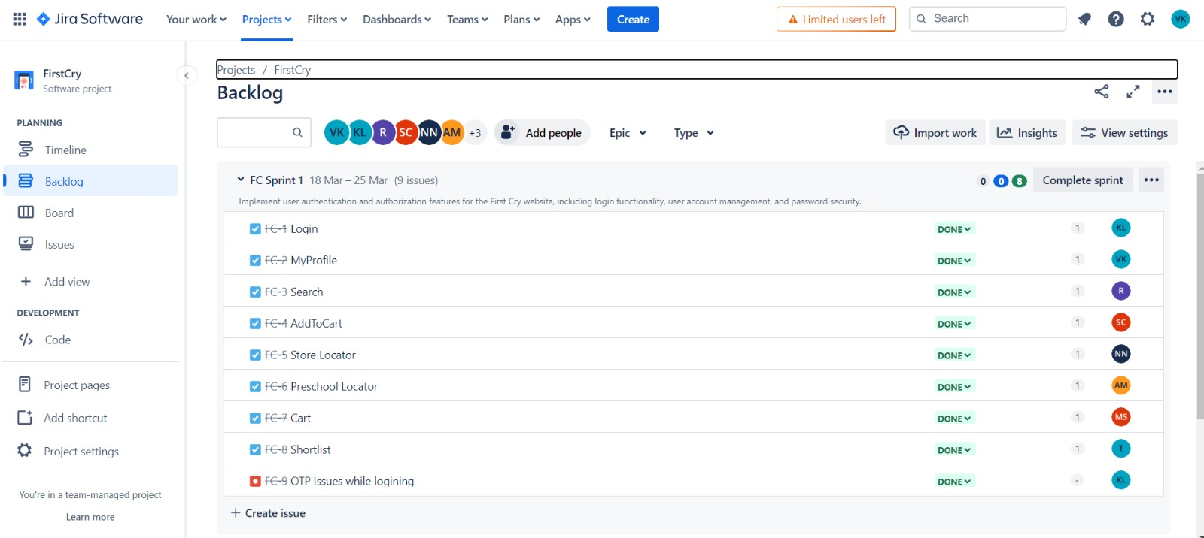

Slide 24
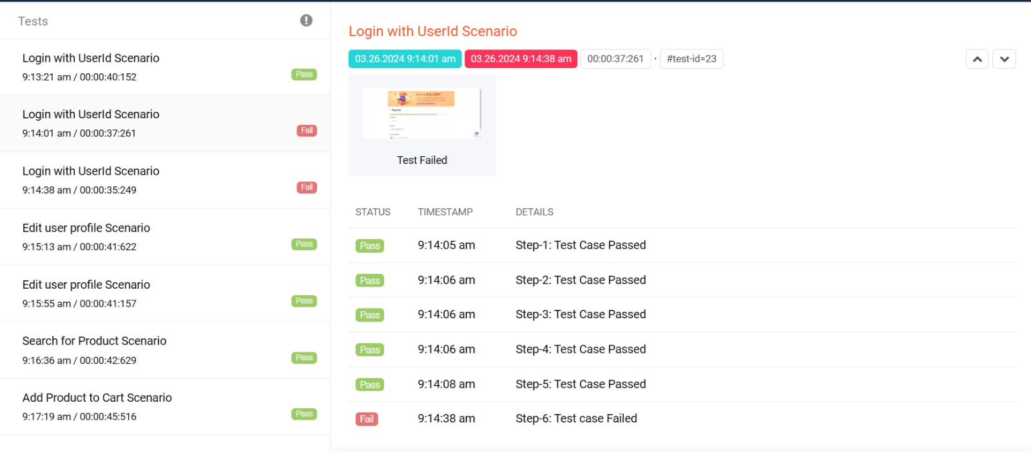
OUTPUT:

Slide 25
THANK YOU

